Slide 1
Electric Go-Kart Data Logger
Developed by Andrew Goeden

Slide 2





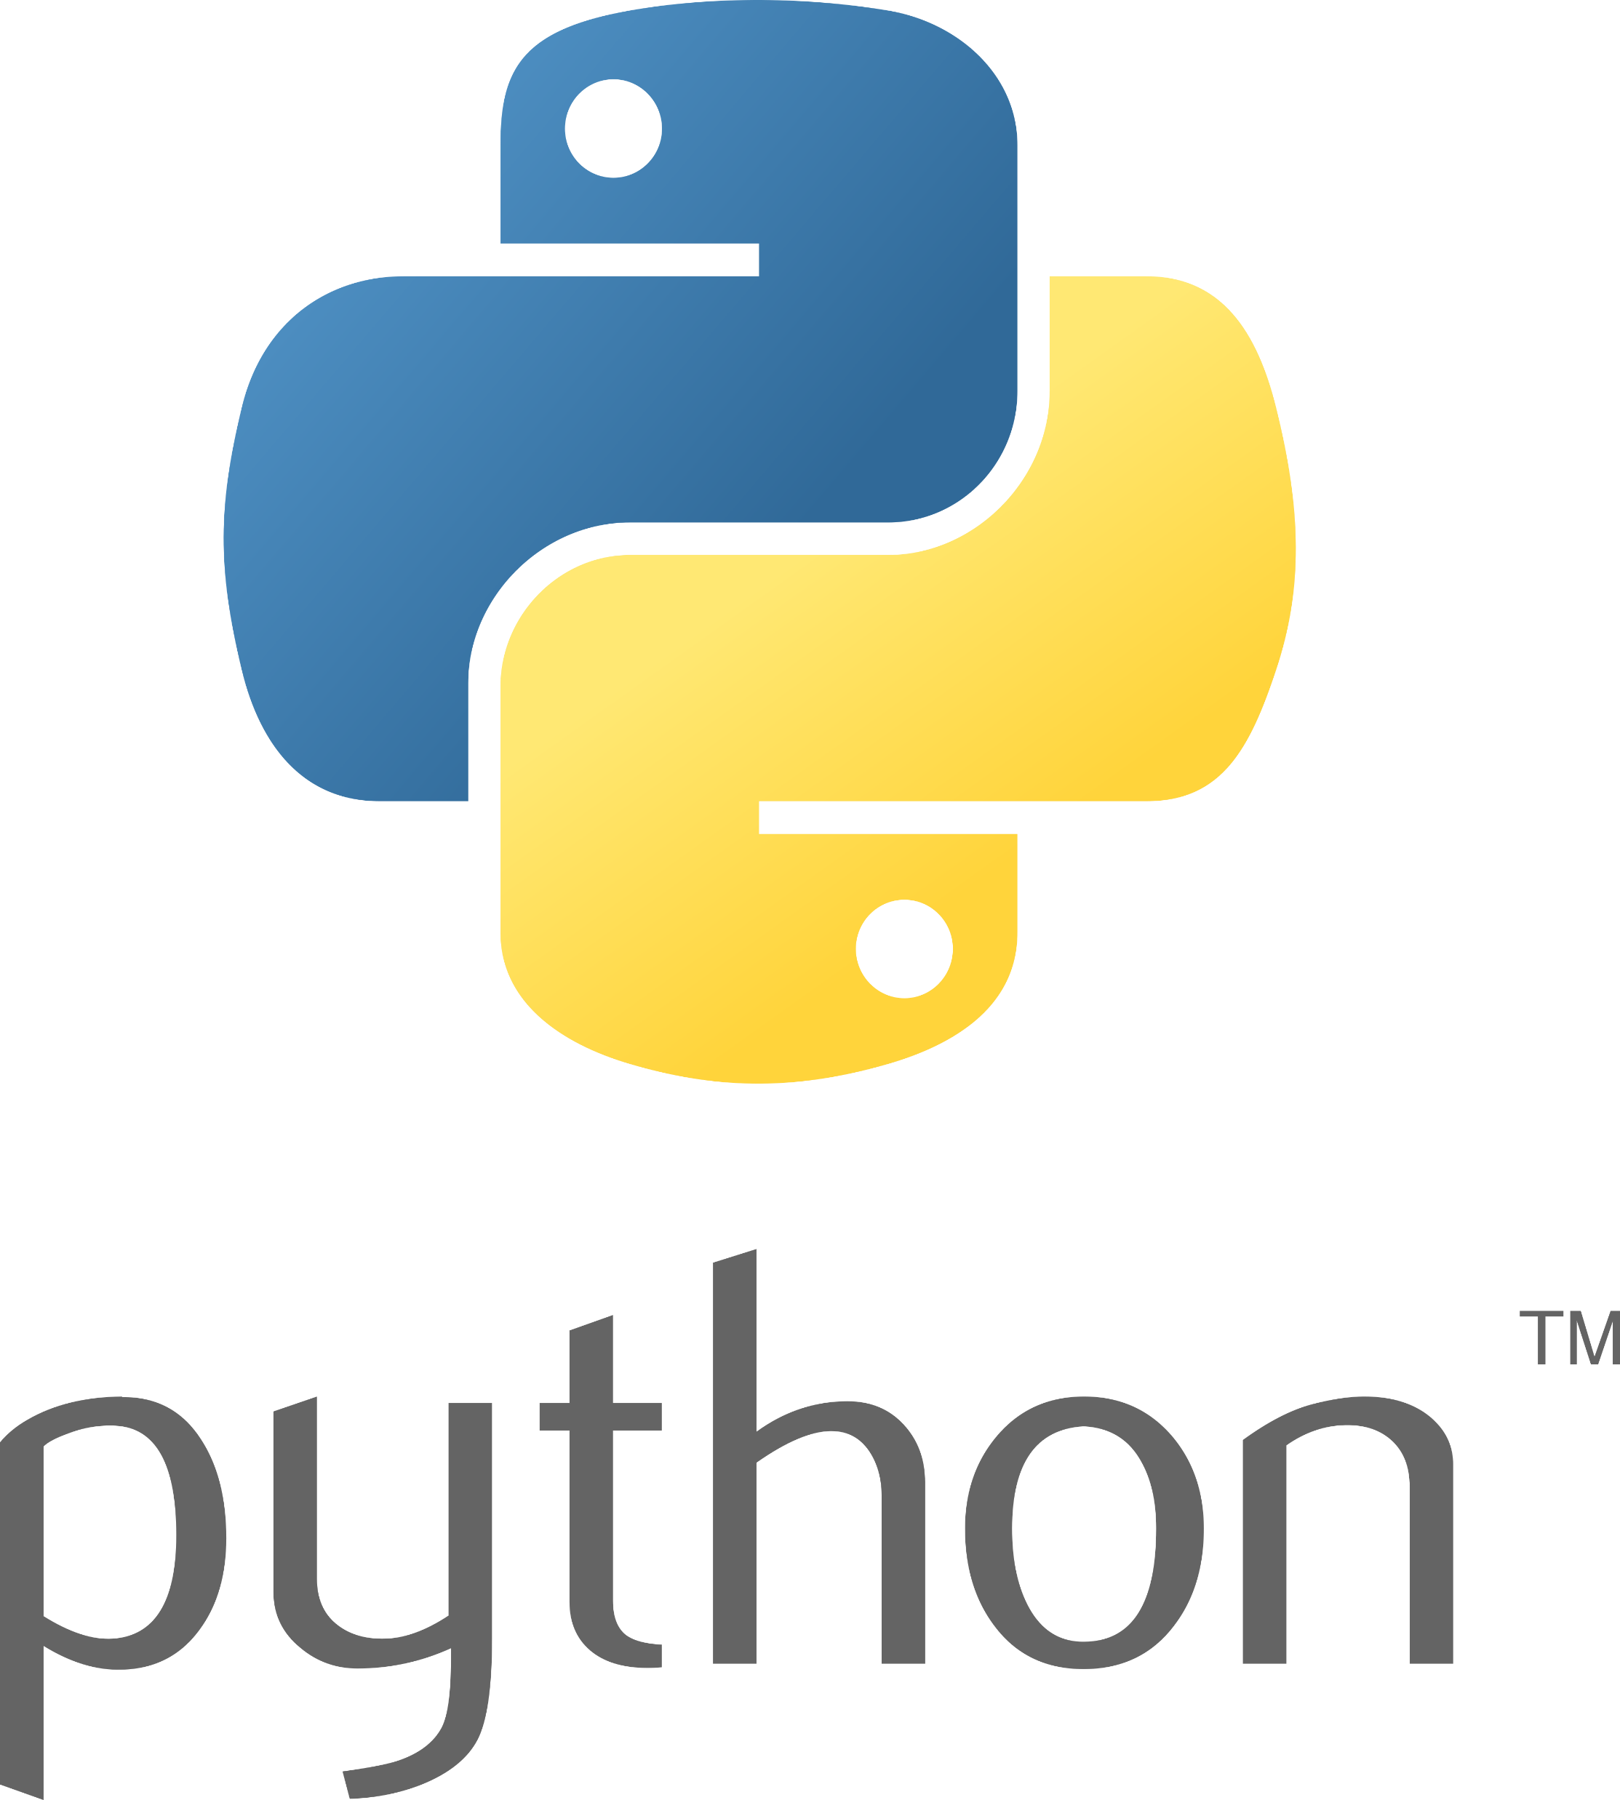

Introduction
This project was done for the Electric Vehicle Team in order to collect useful data about our go-kart for tuning and monitoring purposes.

Slide 3
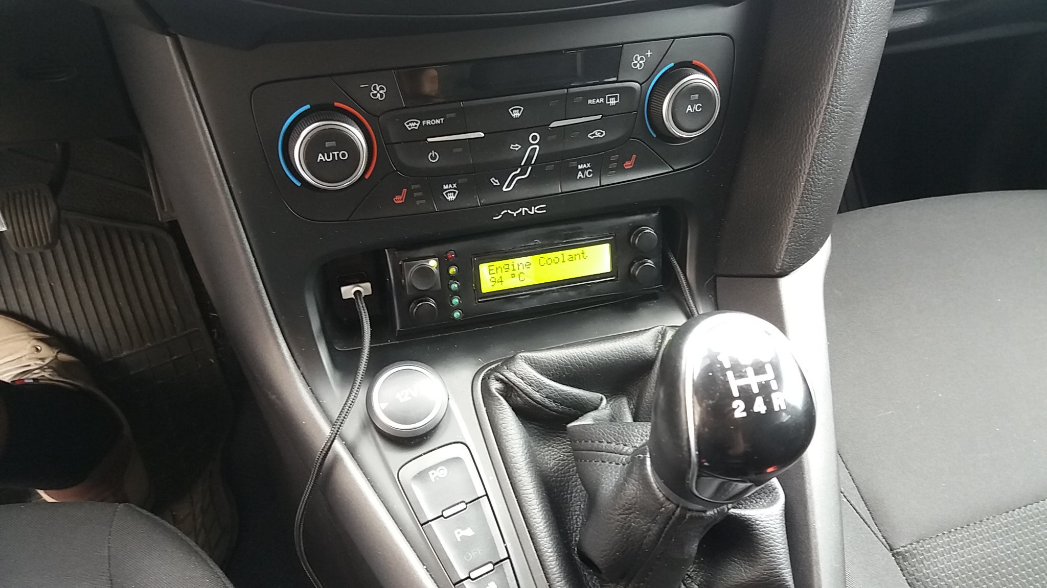
Related Work
Comparable to OBD-II used in automobiles
https://hackaday.io/project/172214/gallery#5811103d0166235dd7eb163e87578931

Slide 4
Challenges
I ran into a plethora of different challenges throughout the design and implementation phases
How to connect to the go-kart CAN Bus
Sending data to the client webpage without making requests (reduce latency)
What platform will be able to run the entire system locally

Slide 5
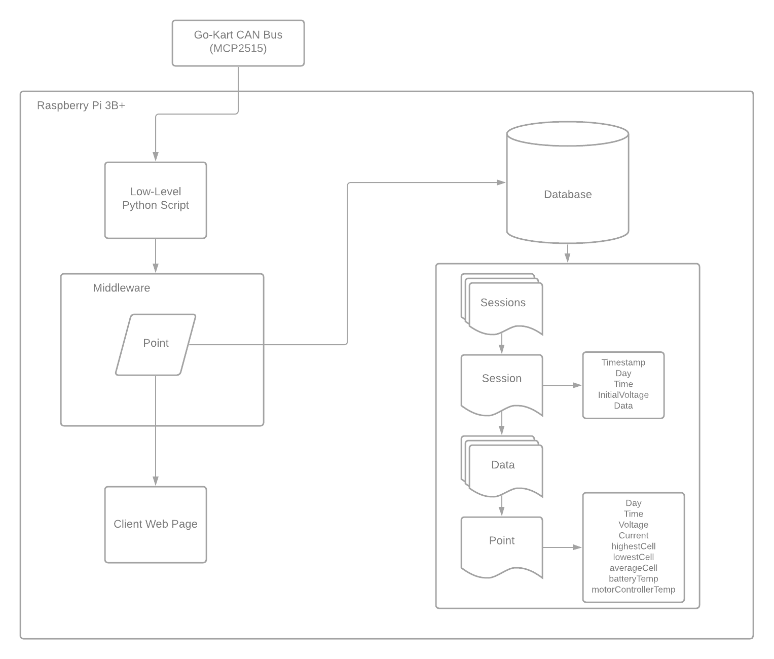
Design

Slide 6
Technical Details
Low-Level
Python script that reads the bytes of data from the CAN bus to send to the middleware
A MCP2515 breakout board enabled me to connect the CAN bus to the Raspberry Pi over SPI (Serial Peripheral Interface)
Middleware
NodeJS server using Express, Express-ws, and Mongoose to create a HTTP API and Websocket
Mongoose enabled me to connect to a MongoDB NoSQL database to store the data
The Express API lets me initialize a current session and sync data across the system
The Websocket lets me send data asynchronously so I can reduce latency of transmission
Web Client
ReactJS webapp using ChartJS to generate graphs to display data
WebSocket library lets me connect to the middleware and listen for messages

Slide 7
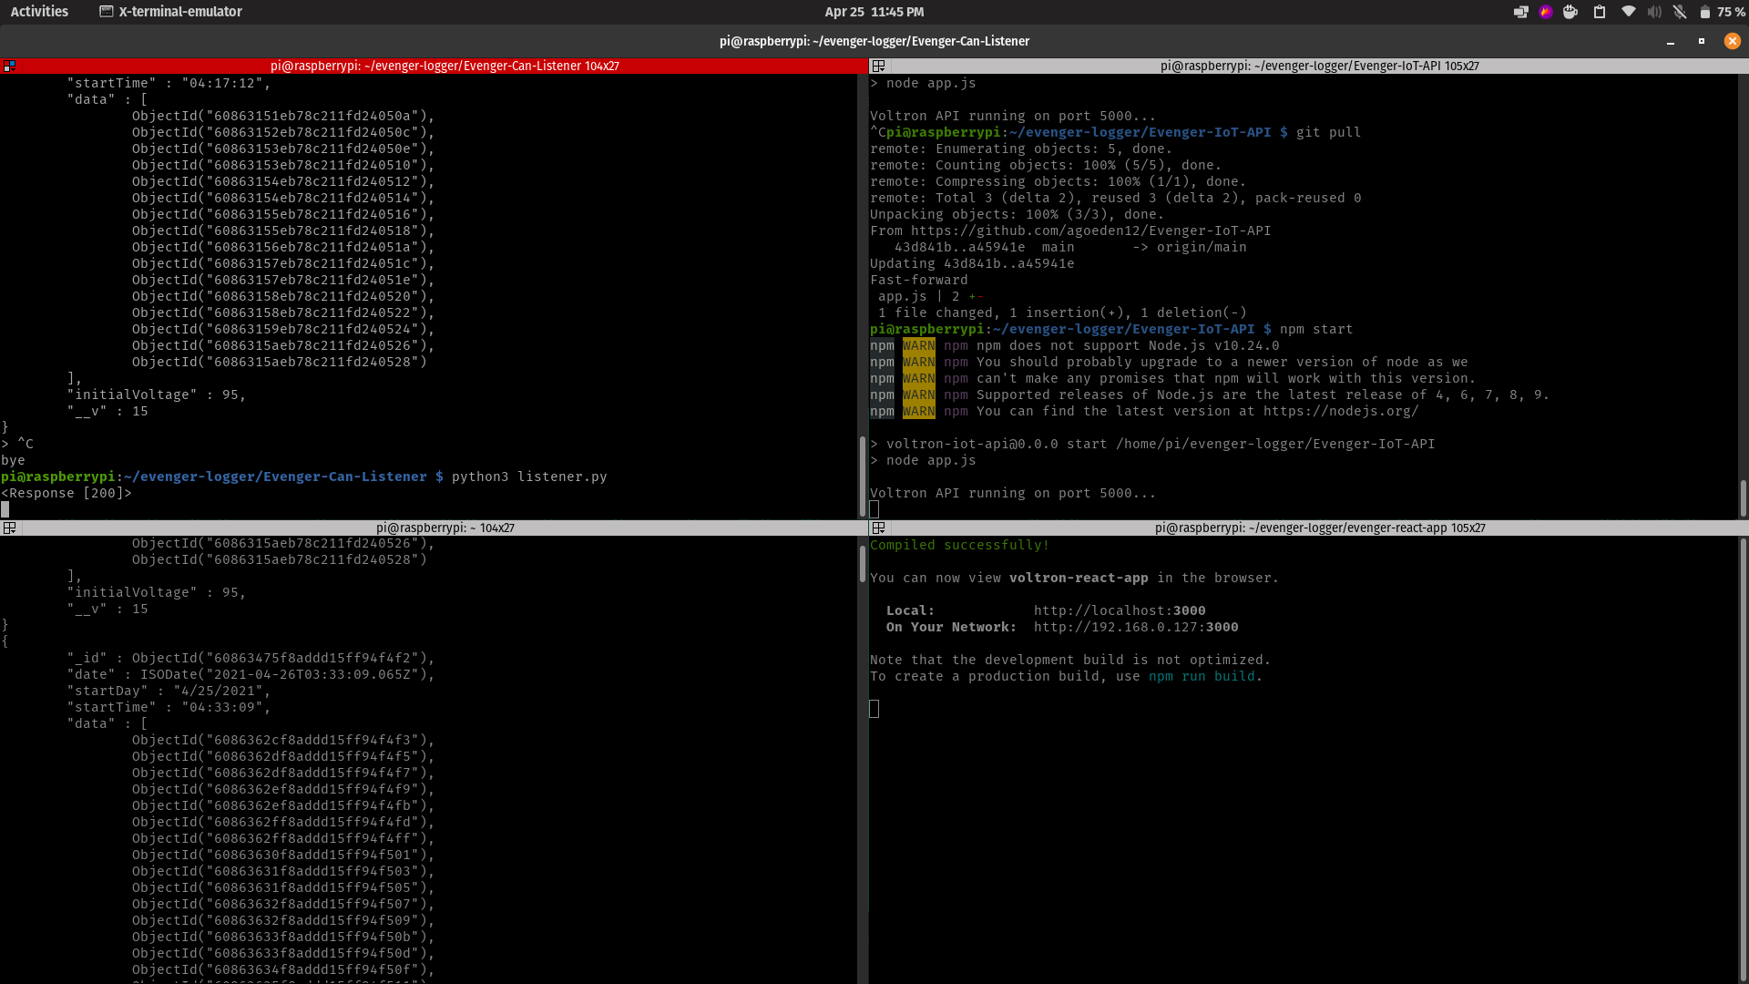
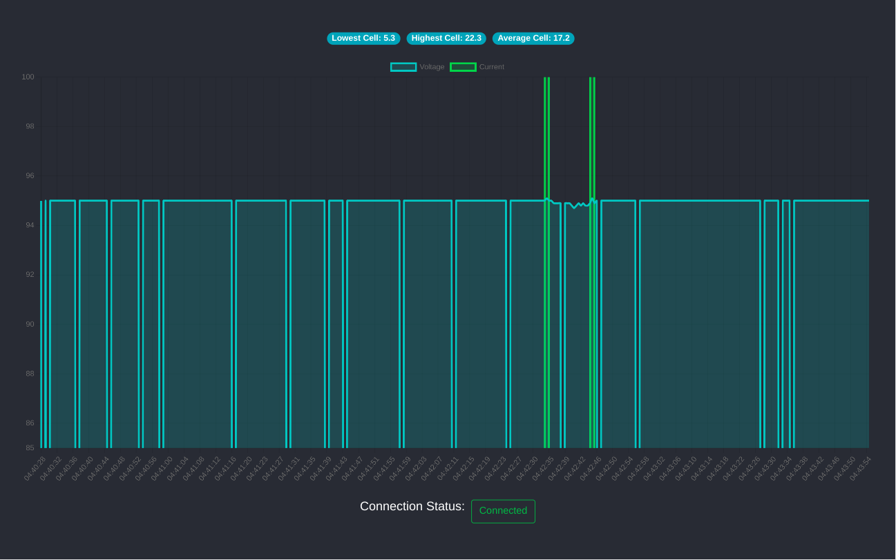
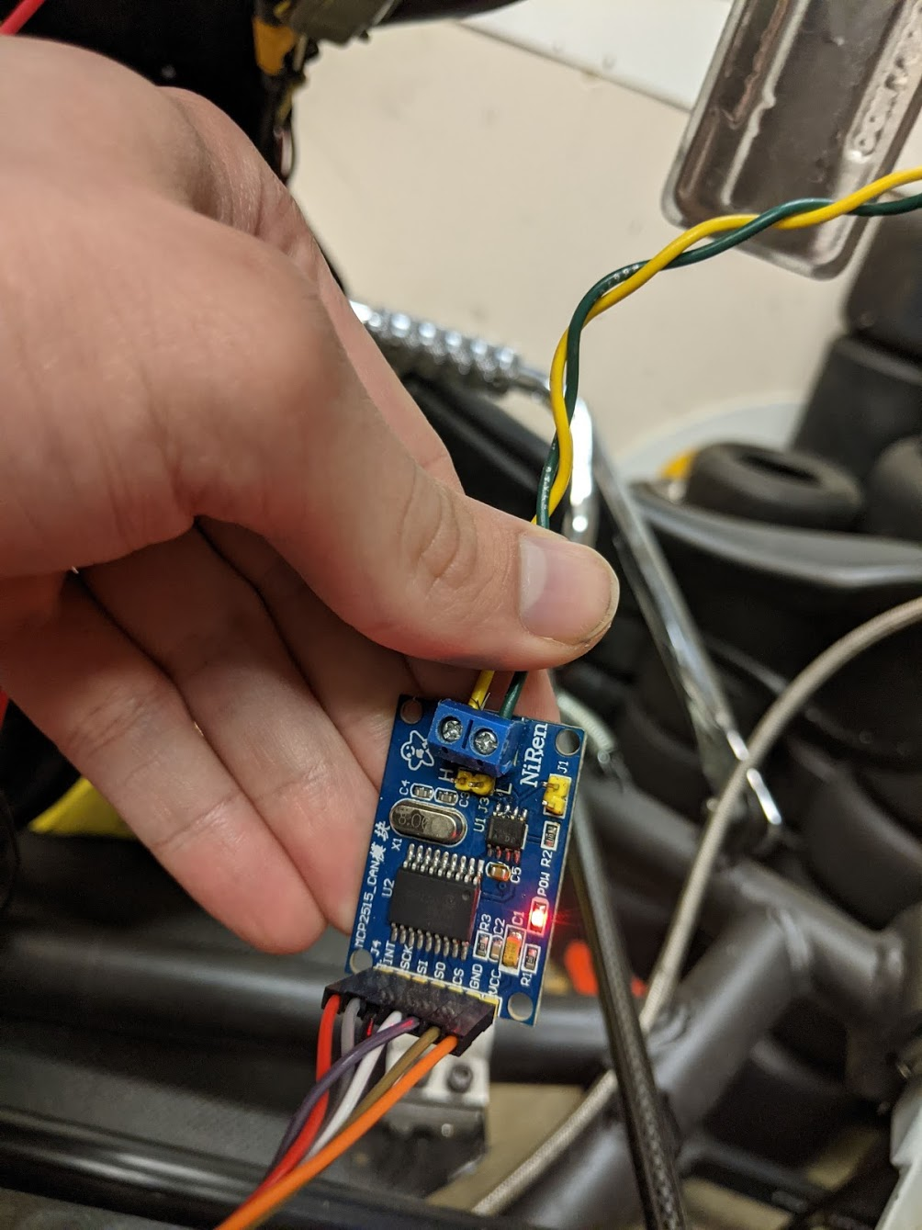
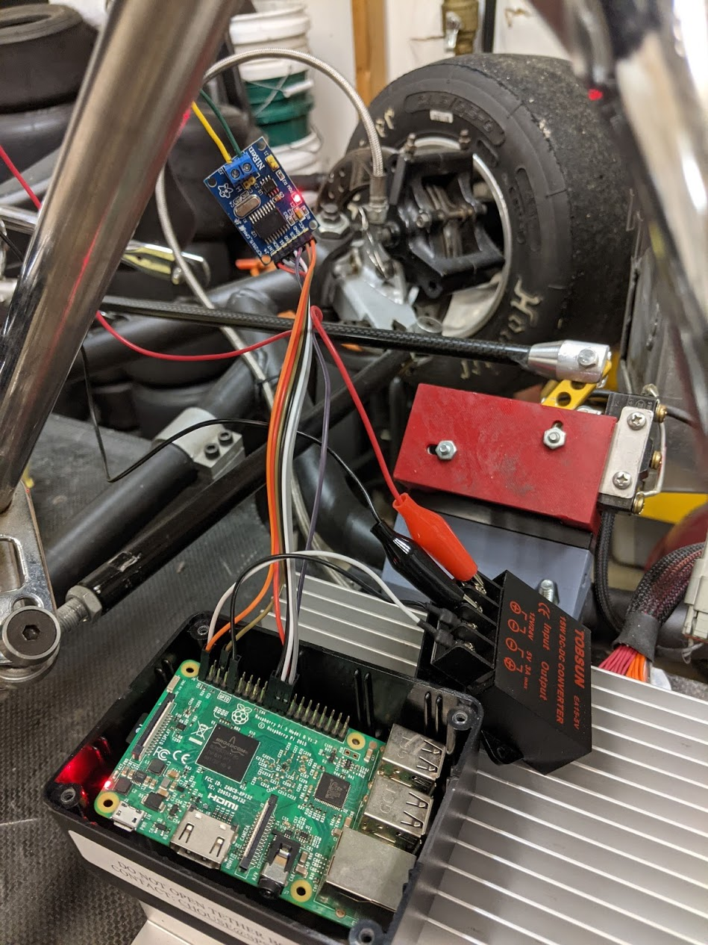
DEMO

Slide 8
Accomplishments & Future Work
I was able to get a complete working system that reads data from the go-kart and sends the data to the database and web app with minimal latency
Future Work:
Migrating the middleware and web app to a server that will enable quicker startup times
The ability to select and view different session data from the web app
Separating the Current and Voltage graphs to better display data

Slide 9
Thank You.
https://github.com/agoeden12/Evenger-IoT-API
https://github.com/agoeden12/Evenger-Can-Listener
https://github.com/agoeden12/evenger-react-app

